Slide 1
Indexing and Hashing
Basic Concepts
Ordered Indices
B+-Tree Index Files
Static Hashing

Slide 2
Basic Concepts
Many queries references only a small proportion of the records in a relation.
E.g. Find all instructors in the Physics department
Indexing mechanisms are introduced in database system to speed up access to desired data.
Search Key - attribute to set of attributes used to look up records in a file.
An Index file consists of records (called index entries) of the form
Index files are typically much smaller than the original file
search-key
pointer

Slide 3
Data File
Index
File
Search key
Record Location
Two basic kinds of indices:
Ordered indices: search keys are stored in sorted order
Hash indices: search keys are distributed uniformly across “buckets” using a “hash function”.

Slide 4
Index Evaluation Metrics
Access types supported efficiently. E.g.,
records with a specified value in the attribute
or records with an attribute value falling in a specified range of values.
Efficiency
Access time
Maintenance cost
Insertion time
Deletion time
Space overhead

Slide 5
Ordered Indices
Indexing techniques evaluated on basis of:
In an ordered index, index entries are stored sorted on the search key value.
Primary index: in a sequentially ordered file, the index whose search key specifies the sequential order of the file.
Also called clustering index
The search key of a primary index is usually but not necessarily the primary key.
Secondary index: an index whose search key specifies an order different from the sequential order of the file. Also called non-clustering index.
Index-sequential file: ordered sequential file with a primary index.

Slide 6
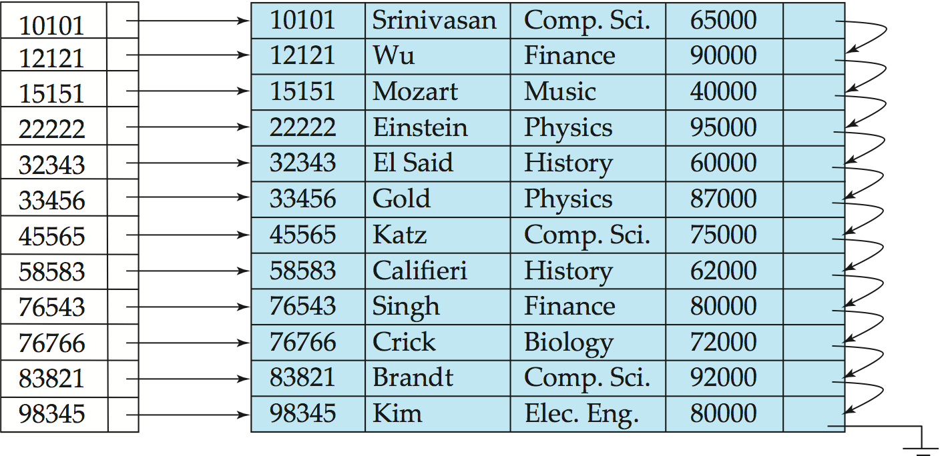
Dense Index Files
Dense index — Index record appears for every search-key value in the file.
E.g. index on ID attribute of instructor relation

Slide 7
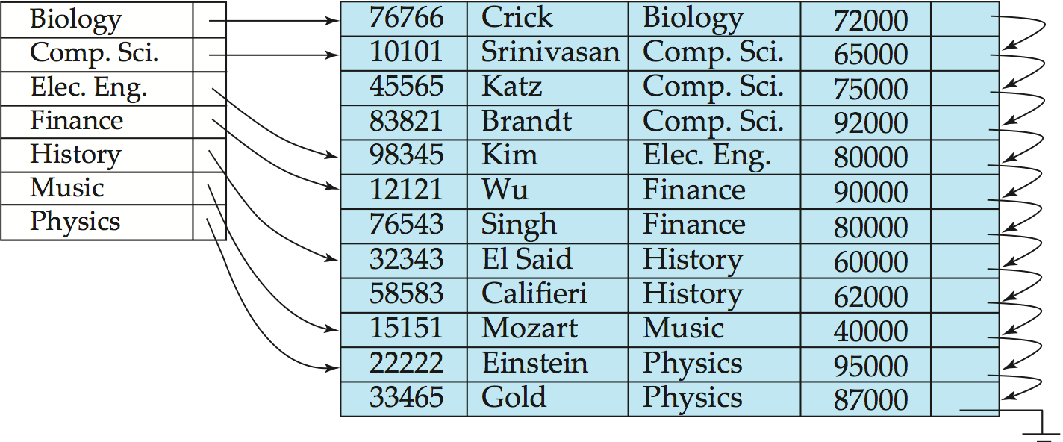
Dense Index Files (Cont.)
Dense index on dept_name, with instructor file sorted on dept_name

Slide 8
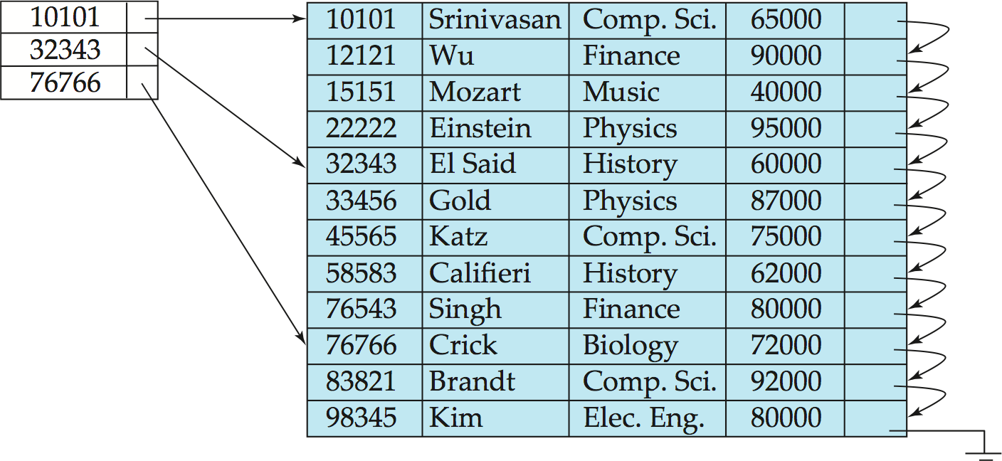
Sparse Index Files
Sparse Index: contains index records for only some search-key values.
Applicable when records are sequentially ordered on search-key
To locate a record with search-key value K we:
Find index record with largest search-key value < K
Search file sequentially starting at the record to which the index record points

Slide 9
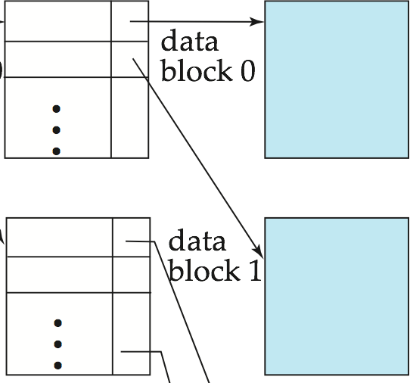
Sparse Index Files (Cont.)
Compared to dense indices:
Less space and less maintenance overhead for insertions and deletions.
Generally slower than dense index for locating records.
Good tradeoff: sparse index with an index entry for every block in file, to locate the block containing the record. Less block to be accessed.

Slide 10
Secondary Indices Example
Secondary index on salary field of instructor
Index record points to a bucket that contains pointers to all the actual records with that particular search-key value.
Secondary indices have to be dense
Notes:
10

Slide 11
Primary and Secondary Indices
Indices offer substantial benefits when searching for records.
BUT: Updating indices imposes overhead on database modification --when a file is modified, every index on the file must be updated
Sequential scan using primary index is efficient, but a sequential scan using a secondary index is expensive
Each record access may fetch a new block from disk
Block fetch requires about 5 to 10 milliseconds, versus about 100 nanoseconds for memory access
Notes:
11

Slide 12
Multilevel Index
If primary index does not fit in memory, access becomes expensive.
To reduce number of disk accesses to index records, treat primary index kept on disk as a sequential file and construct a sparse index on it.
outer index – a sparse index of primary index
inner index – the primary index file
If even outer index is too large to fit in main memory, yet another level of index can be created, and so on.
Indices at all levels must be updated on insertion or deletion from the file.

Slide 13
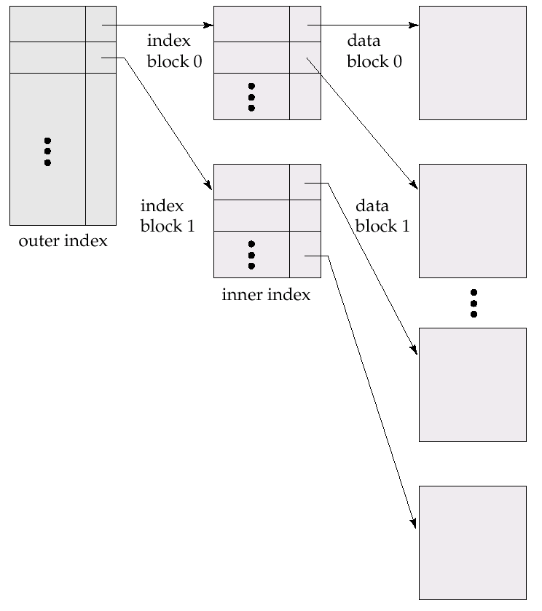
Multilevel Index (Cont.)

Slide 14
Index Update: Deletion
If deleted record was the only record in the file with its particular search-key value, the search-key is deleted from the index also.
Single-level index deletion:
Dense indices – deletion of search-key is similar to file record deletion.
Sparse indices – if an entry for the search key exists in the index, it is deleted by replacing the entry in the index with the next search-key value in the file (in search-key order). If the next search-key value already has an index entry, the entry is deleted instead of being replaced.

Slide 15
Index Update: Insertion
Single-level index insertion:
Perform a lookup using the search-key value appearing in the record to be inserted.
Dense indices – if the search-key value does not appear in the index, insert it.
Sparse indices – if index stores an entry for each block of the file, no change needs to be made to the index unless a new block is created. In this case, the first search-key value appearing in the new block is inserted into the index.
Multilevel insertion (as well as deletion) algorithms are simple extensions of the single-level algorithms

Slide 16
B⁺-Tree Index Files
B⁺-tree indices are an alternative to indexed-sequential files.
Disadvantage of indexed-sequential files:
performance degrades as file grows, since many overflow blocks get created.
Periodic reorganization of entire file is required.
Advantage of B⁺-tree index files:
automatically reorganizes itself with small, local, changes, in the face of insertions and deletions.
Reorganization of entire file is not required to maintain performance.
Disadvantage of B⁺-trees:
extra insertion and deletion overhead, space overhead.
Advantages of B⁺-trees outweigh disadvantages, and they are used extensively.

Slide 17
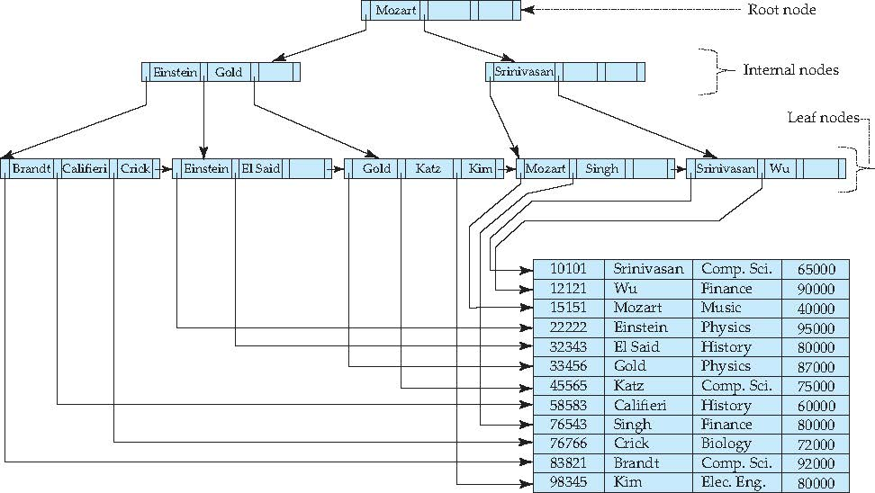
Example of B+-Tree

Slide 18
B⁺-Tree Index Files (Cont.)
A B⁺-tree is a rooted tree satisfying the following properties:
All paths from root to leaf are of the same length
Each node that is not a root or a leaf has between ⎡n/2⎤ and n children.
A leaf node has between ⎡(n–1)/2 ⎤ and n–1 values
Special cases:
If the root is not a leaf, it has at least 2 children.
If the root is a leaf (that is, there are no other nodes in the tree), it can have between 0 and (n–1) values.
n stands for: numbers of points in a node.

Slide 19
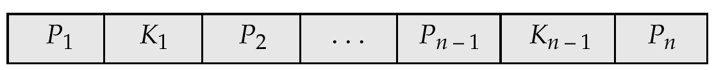
B⁺-Tree Node Structure
Typical node
K_{i} are the search-key values
P_{i} are pointers to children (for non-leaf nodes) or pointers to records or buckets of records (for leaf nodes).
The search-keys in a node are ordered
K₁ < K₂ < K₃ < . . . < K_{n–1}

Slide 20
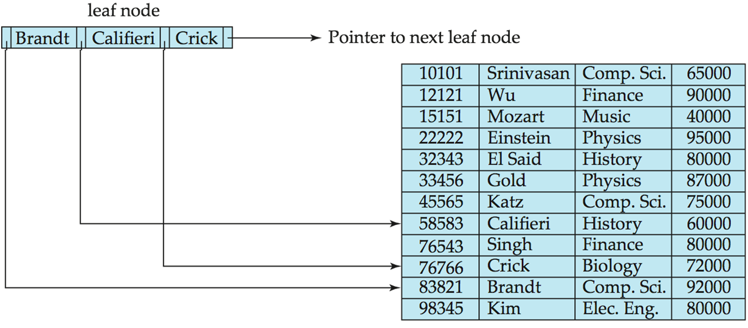
Leaf Nodes in B⁺-Trees
For i = 1, 2, . . ., n–1, pointer P_{i} either points to a file record with search-key value K_{i}, or to a bucket of pointers to file records, each record having search-key value K_{i}. Only need bucket structure if search-key does not form a unique key.
If L_{i}, L_{j} are leaf nodes and i < j, L_{i}’s search-key values are less than L_{j}’s search-key values
P_{n} points to next leaf node in search-key order

Slide 21
Non-Leaf Nodes in B⁺-Trees
Non leaf nodes form a multi-level sparse index on the leaf nodes. For a non-leaf node with m pointers:
All the search-keys in the subtree to which P₁ points are less than K₁
For 2 ≤ i ≤ n – 1, all the search-keys in the subtree to which P_{i} points have values greater than or equal to K_{i–1} and less than K_{j}
[K_{i–1} , K_{i} )
All the search-keys in the subtree to which P_{n} points have values greater than or equal to K_{n–1}

Slide 22
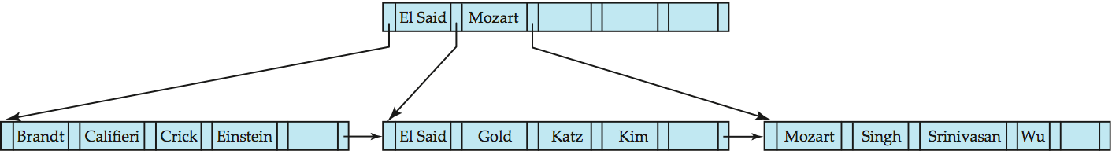
Example of B⁺-tree
B⁺-tree for instructor file (n = 6)
Leaf nodes must have between 3 and 5 values (⎡(n–1)/2⎤ and n –1, with n = 6).
Non-leaf nodes other than root must have between 3 and 6 children (⎡(n/2⎤ and n with n =6).
Root must have at least 2 children.

Slide 23
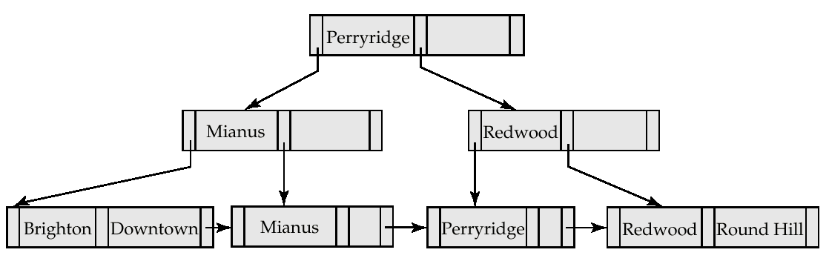
Example of a B⁺-tree
B⁺-tree for account file (n = 3)

Slide 24
Observations about B⁺-trees
Since the inter-node connections are done by pointers, “logically” close blocks need not be “physically” close.
The non-leaf levels of the B⁺-tree form a hierarchy of sparse indices.
The B⁺-tree contains a relatively small number of levels (logarithmic in the size of the main file), thus searches can be conducted efficiently.
Insertions and deletions to the main file can be handled efficiently, as the index can be restructured in logarithmic time (as we shall see).

Slide 25
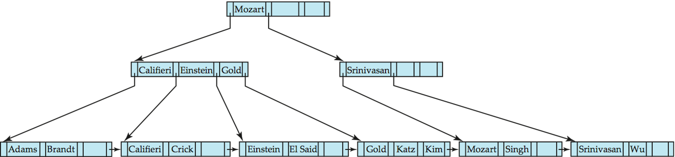
Queries on B⁺-Trees
Find all records with a search-key value of k.
Start with the root node
Examine the node for the smallest number j that K_{j-1} < k <= K_{j} .
If such K_{j} exists, if k < K_{j} then N = P_{j} else N = P_{j+1}
Otherwise k ≥ K_{m–1}, where there are m pointers in the node. Then N=P_{m}
Follow point N to the child node.
If the node reached by following the pointer above is not a leaf node, repeat the above procedure on the node, and follow the corresponding pointer.
Eventually reach a leaf node. If for some i, key K_{i} = k follow pointer P_{i} to the desired record or bucket. Else no record with search-key value k exists.

Slide 26
Handling Duplicates*
With duplicate search keys
In both leaf and internal nodes,
not necessary to guarantee that K₁ < K₂ < K₃ < . . . < K_{n–1}
but can guarantee K₁ ≤ K₂ ≤ K₃ ≤ . . . ≤ K_{n–1}
Search-keys in the subtree to which P_{i} points
are ≤ K_{i,}, but not necessarily < K_{i,}
To see why, suppose same search key value V is present in two leaf node L_{i} and L_{i+1}. Then in parent node K_{i} must be equal to V

Slide 27
Queries on B⁺⁻Trees (Cont.)
In processing a query, a path is traversed in the tree from the root to some leaf node.
If there are K search-key values in the file, the path is no longer than ⎡ log_{⎡n/2⎤}(K)⎤.
A node is generally the same size as a disk block, typically 4 kilobytes, and n is typically around 100 (40 bytes per index entry).
With 1 million search key values and n = 100, at most log₅₀(1,000,000) = 4 nodes are accessed in a lookup.
Contrast this with a balanced binary free with 1 million search key values — around 20 nodes are accessed in a lookup
above difference is significant since every node access may need a disk I/O, costing around 20 milliseconds!

Slide 28
Updates on B⁺-Trees: Insertion
Find the leaf node in which the search-key value would appear
If the search-key value is already there in the leaf node, record is added to file and if necessary a pointer is inserted into the bucket.
If the search-key value is not there, then add the record to the main file and create a bucket if necessary. Then:
If there is room in the leaf node, insert (key-value, pointer) pair in the leaf node
Otherwise, split the node (along with the new (key-value, pointer) entry) as discussed in the next slide.

Slide 29
Updates on B⁺-Trees: Insertion (Cont.)
Splitting a node:
take the n(search-key value, pointer) pairs (including the one being inserted) in sorted order. Place the first ⎡ n/2 ⎤ in the original node, and the rest in a new node.
let the new node be p, and let k be the least key value in p. Insert (k,p) in the parent of the node being split.
If the parent is full, split it and propagate the split further up.
The splitting of nodes proceeds upwards till a node that is not full is found. In the worst case the root node may be split increasing the height of the tree by 1.
Result of splitting node containing Brandt, Califieri and Crick on inserting Adams
Next step: insert entry with (Califieri,pointer-to-new-node) into parent

Slide 30
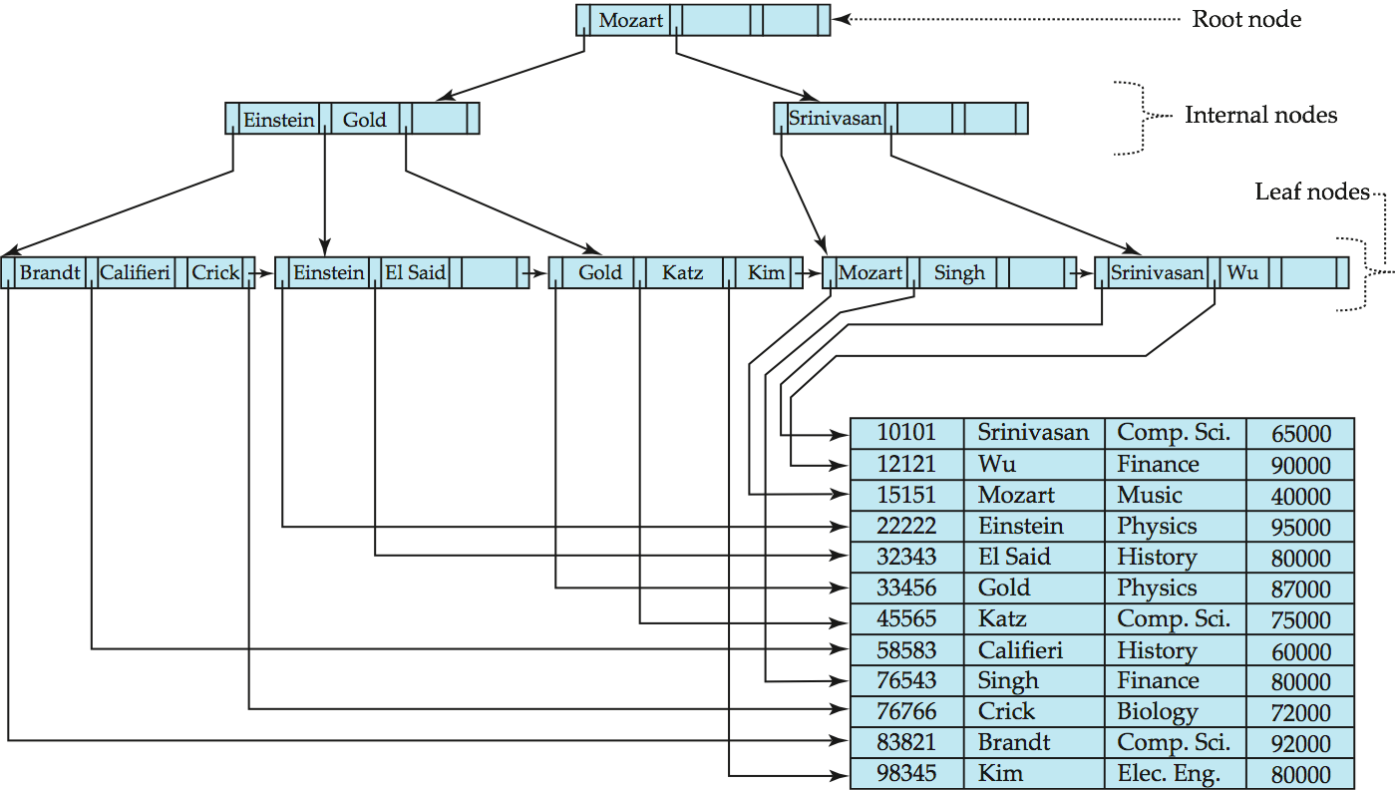

B⁺-Tree Insertion
B⁺-Tree before and after insertion of “Adams”

Slide 31
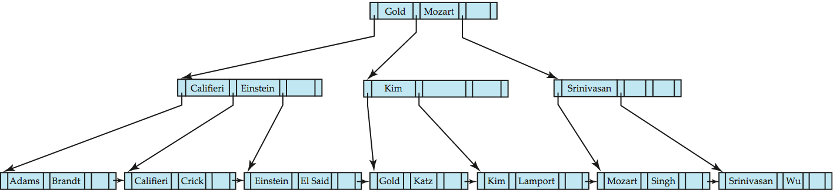
B+-Tree Insertion
B⁺-Tree before and after insertion of “Lamport”

Slide 32
Insert Algorithm
Procedure bpt_insert(value V, point P)
检索B+树，找到应该包含值V的叶节点L;
insert_entry(L,V,P);
end procedure
Procedure insert_entry(node L,value V, point P)
if( L 有空间插入 (V, P)) then
将 (V, P) 插入 L;
else
/* step1: 分裂 */
创建新的节点 L';
if ( L 是叶节点 ) then
设 K1,P1,K2,P2,...., Kn, Pn是在L中插入(V, P)以后的序列LL
m = n/2;
将序列LL中的K1,P1,...,Km,Pm保留在节点L;
将Km+1,Pm+1,...,Kn,Pn移到新节点K';
V' = Km+1;
L'.next = L.next; /* 建立叶节点的邻接指针*/
L.next = L';

Slide 33
Insert Algorithm (cont.)
else /* L 不是叶节点 */
设 P0,K1,P1,K2,P2,...., Kn, Pn是在L中插入(V, P)以后的序列LL
m = n/2;
将序列LL中的P0,K1,...,Km-1,Pm-1保留在节点L;将Pm,Km+1,Pm+1,...,Kn,Pn移到新节点K';
/* 注意：序列中的Km被删去 */
V' = Km;
/* step2: 插入上级节点 */
if ( L不是根节点 ) then
insert_entry(parent(L),V',L'); /* 递归调用 */
else
创建新的节点R,其中包含：L, V', L'
节点R成为新的根节点；
endif
end of procedure;

Slide 34
More Insert examples
Insert following numbers to a B+ tree (n=3):
2， 9， 5， 10， 11， 7， 4
9
2
2,9
2,5,9
2,5
9
9
9,11
9
2,5
9,10
2,5
9,10,11
2,5
9,10
11

Slide 35
More Insert examples (cont.)
9,11
7,9,11
2,5,7
9,10
11
2,5
7
9,10
11
9
9
7
11
5, 7
11
2,5
7
9,10
11
2,4
5
7
9,10
11

Slide 36
Updates on B⁺-Trees: Deletion
Find the record to be deleted, and remove it from the main file and from the bucket (if present)
Remove (search-key value, pointer) from the leaf node if there is no bucket or if the bucket has become empty
If the node has too few entries due to the removal, and the entries in the node and a sibling can fit into a single node, then
Insert all the search-key values in the two nodes into a single node (the one on the left), and delete the other node.
Delete the pair (K_{i–1}, P_{i}), where P_{i} is the pointer to the deleted node, from its parent, recursively using the above procedure.

Slide 37
Updates on B⁺-Trees: Deletion
Otherwise, if the node has too few entries due to the removal, and the entries in the node and a sibling can NOT fit into a single node, then
Redistribute the pointers between the node and a sibling such that both have more than the minimum number of entries.
Update the corresponding search-key value in the parent of the node.
The node deletions may cascade upwards till a node which has ⎡n/2 ⎤ or more pointers is found. If the root node has only one pointer after deletion, it is deleted and the sole child becomes the root.

Slide 38
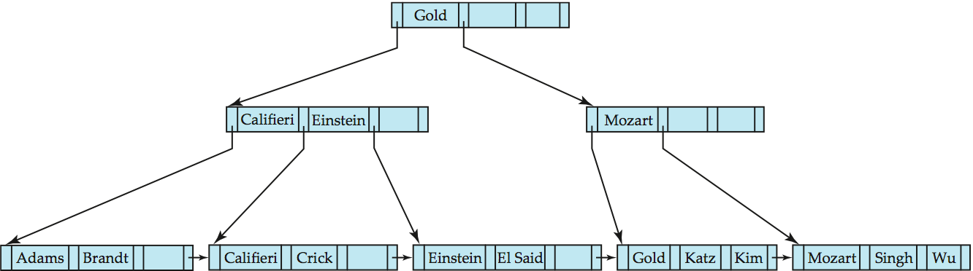
Examples of B⁺-Tree Deletion
Before and after deleting “Srinivasan”
Deleting “Srinivasan” causes merging of under-full leaves

Slide 39
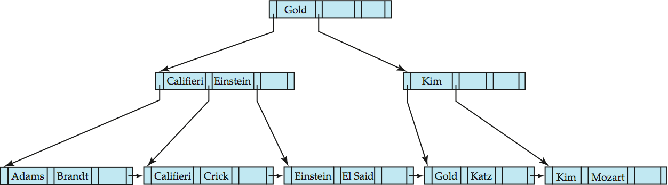
Examples of B⁺-Tree Deletion (Cont.)
Deletion of “Singh” and “Wu” from result of previous example
Leaf containing Singh and Wu became underfull, and borrowed a value Kim from its left sibling
Search-key value in the parent changes as a result

Slide 40
Delete Algorithm
Procedure bpt_delete(value V, point P)
检索B+树，找到包含值(V,P)的叶节点L;
delete_entry(L,V,P);
end procedure
Procedure delete_entry(node L,value V, point P)
从节点L中删除(V,P);
if( L是根节点并且只剩下一个子节点) then
将索引的根节点置为L的唯一子节点后成功返回；
endif
if (节点L中的空闲空间低于B+树规定的最小值) then /* 需要合并 */
通过parent(L)获得L'为L在同一层次上的前一个或者是后一个节点;
设V'是L和L'在parent(L)中的分隔索引值；
if ( L和L'中的内容可以在一个节点中存放 ) then
将所有有效数据存放在两个节点中的前一个节点；
物理删除后一个节点；
delete_entry(parent(L),V',后一个节点的指针); /* 递归调用 */

Slide 41
Delete Algorithm (cont.)
elseif /* 需要重新分配L和L'中的内容 */
if (L’在L的前面) then
将L’中的最后一个指针移到L中；
/* 需要增加的键值对于中间节点是V’;
对于页节点则是原L’中的最后一个键值 */
用L’中原来最后的一个键值替换Parent(L)中的键值V’;
else
将L’中的第一个指针移到L中；
/* 需要增加的键值对于中间节点是V’;
对于页节点则是原L’中的第一个键值 */
用L’中原来第一个键值替换Parent(L)中的键值V’;
endif
endif
endif /* 合并 */
end procedure

Slide 42
More Delete examples
Delete following numbers from a B+ tree (n=3):
11，4，7
9
9
5, 7
11
5, 7
11
2,4
5
7
9,10
11
2,4
5
7
9,10
9
9
5, 7
5, 7
9
2,4
5
7
9,10
2,4
5
7
9,10

Slide 43
More Delete examples (cont.)
7
7
5
9
5
9
2,4
5
7
9,10
2
5
7
9,10
7
7
5
9
5
9
2
5
9,10
2
5
9,10
9,10
7
7
5,7
5
5,7
2
5
9,10
2
5
9,10
2
5
9,10

Slide 44
Non-Unique Search Keys
Alternatives to scheme described earlier
List of tuple pointers with each key
Extra code to handle long lists
Deletion of a tuple can be expensive if there are many duplicates on search key (why?)
Low space overhead, no extra cost for queries
Make search key unique by adding a record-identifier
Extra storage overhead for keys
Simpler code for insertion/deletion
Widely used
Notes:
44

Slide 45
Indexing Strings
Variable length strings as keys
Variable fanout
Use space utilization as criterion for splitting, not number of pointers
Prefix compression
Key values at internal nodes can be prefixes of full key
Keep enough characters to distinguish entries in the subtrees separated by the key value
E.g. “Silas” and “Silberschatz” can be separated by “Silb”
Keys in leaf node can be compressed by sharing common prefixes

Slide 46
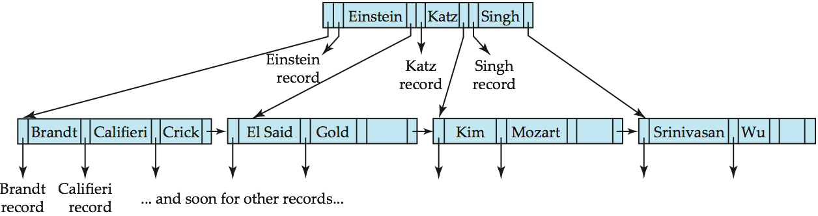
B-Tree Index File
B-tree (above) and B+-tree (below) on same data

Slide 47
Static Hashing
The disadvantage of sequential file organization and index structure require extra storage and overhead of indexing.
File organization based on the technique of hashing
A bucket is a unit of storage containing one or more records (a bucket is typically a disk block).
In a hash file organization we obtain the bucket of a record directly from its search-key value using a hash function.
Hash function h is a function from the set of all search-key values K to the set of all bucket addresses B.
Hash function is used to locate records for access, insertion as well as deletion.
Records with different search-key values may be mapped to the same bucket; thus entire bucket has to be searched sequentially to locate a record.

Slide 48
Example of Hash File Organization
Hash file organization of instructor file, using dept_name as key (See figure in next slide.)
There are 10 buckets,
The binary representation of the ith character is assumed to be the integer i.
The hash function returns the sum of the binary representations of the characters modulo 10
E.g. h(Music) = 1 h(History) = 2 h(Physics) = 3 h(Elec. Eng.) = 3

Slide 49

Example of Hash File Organization
Hash file organization of instructor file, using dept_name as key (see previous slide for details).

Slide 50
Hash Functions
Worst hash function maps all search-key values to the same bucket; this makes access time proportional to the number of search-key values in the file.
An ideal hash function is uniform, i.e., each bucket is assigned the same number of search-key values from the set of all possible values.
Ideal hash function is random, so each bucket will have the same number of records assigned to it irrespective of the actual distribution of search-key values in the file.
Typical hash functions perform computation on the internal binary representation of the search-key.
For example, for a string search-key, the binary representations of all the characters in the string could be added and the sum modulo the number of buckets could be returned.

Slide 51
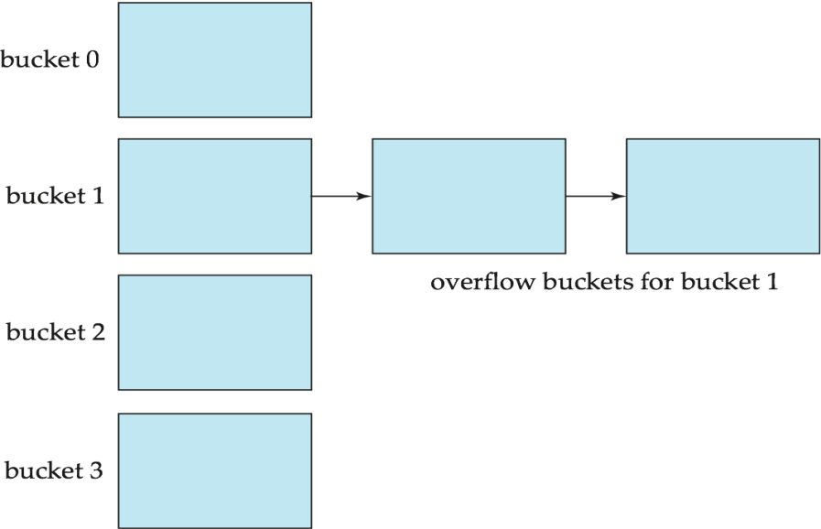
Handling of Bucket Overflows
Bucket overflow can occur because of
Insufficient buckets
Skew in distribution of records. This can occur due to two reasons:
multiple records have same search-key value
chosen hash function produces non-uniform distribution of key values
Although the probability of bucket overflow can be reduced, it cannot be eliminated; it is handled by using overflow buckets.
Rehashing

Slide 52
Hash Indices
Hashing can be used not only for file organization, but also for index-structure creation.
A hash index organizes the search keys, with their associated record pointers, into a hash file structure.
Strictly speaking, hash indices are always secondary indices
if the file itself is organized using hashing, a separate primary hash index on it using the same search-key is unnecessary.
However, we use the term hash index to refer to both secondary index structures and hash organized files.

Slide 53
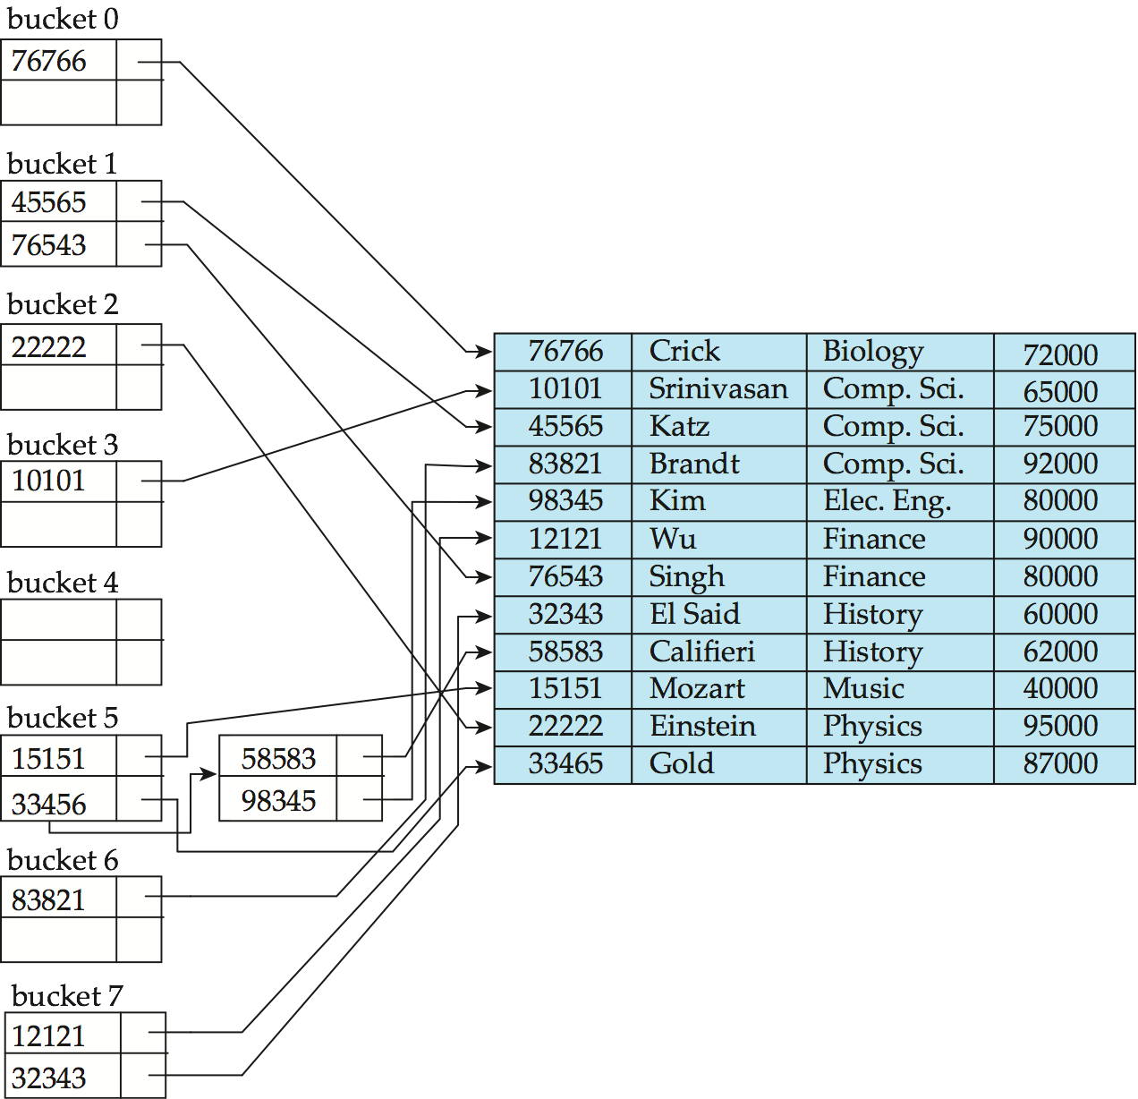
Example of Hash Index
hash index on instructor, on attribute ID

Slide 54
Dynamic Hashing
Good for database that grows and shrinks in size
Allows the hash function to be modified dynamically
Extendable hashing – one form of dynamic hashing
Hash function generates values over a large range — typically b-bit integers, with b = 32.
At any time use only a prefix of the hash function to index into a table of bucket addresses.
Let the length of the prefix be i bits, 0 ≤ i ≤ 32.
Bucket address table size = 2^{i.} Initially i = 0
Value of i grows and shrinks as the size of the database grows and shrinks.
Multiple entries in the bucket address table may point to a bucket (why?)
Thus, actual number of buckets is < 2^{i}
The number of buckets also changes dynamically due to coalescing and splitting of buckets.

Slide 55
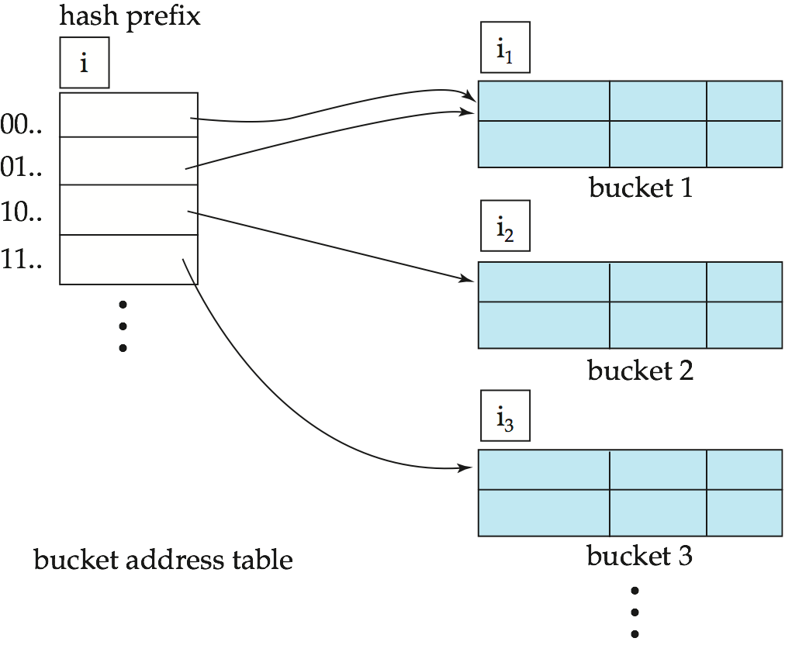
General Extendable Hash Structure
In this structure, i₂ = i₃ = i, whereas i₁ = i – 1

